Slide 2
Survey Technician Certification Program
Revised August 21, 2023

Slide 3
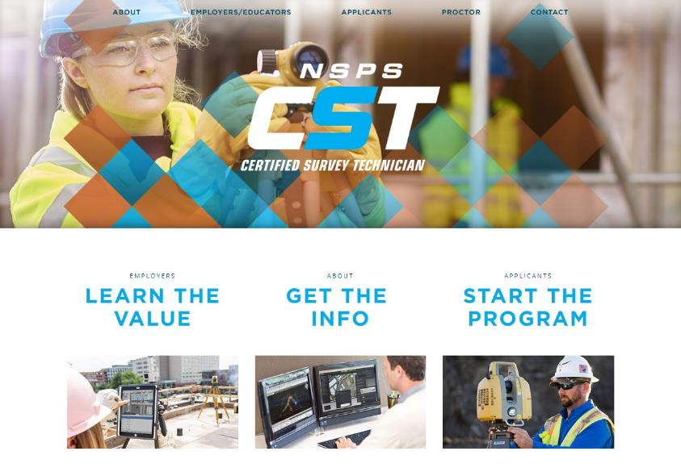

Slide 4
The Certified Survey Technician program (CST) is a comprehensive national certification program for survey technicians and is sponsored by the National Society of Professional Surveyors.
Survey Technician Certification Program

Slide 5
WHAT IS THE CST PROGRAM?
Four levels of certification are offered in two primary tracks – field and office. Certification is by examination, which must be monitored by an approved Proctor.
Survey Technician Certification Program

Slide 6
WHAT IS THE CST PROGRAM?
The Certified Survey Technician Board administers the program, which is intended to gauge technical capabilities and general knowledge of workplace safety and procedures.
Survey Technician Certification Program

Slide 7
CST BOARD MISSION:
To promote and recognize the importance of technicians to the surveying and mapping profession.
To encourage and support the development of competent technicians.
Survey Technician Certification Program

Slide 8
CST PROGRAM GOALS:
Recognize the important contribution that technicians provide to the surveying and mapping profession.
Provide credentials to technicians for career advancement.
Identify those technicians who have achieved specific technical competencies.
Provide employers with a way to evaluate applicants and an opportunity to promote the quality of their technical staff.
Survey Technician Certification Program

Slide 9
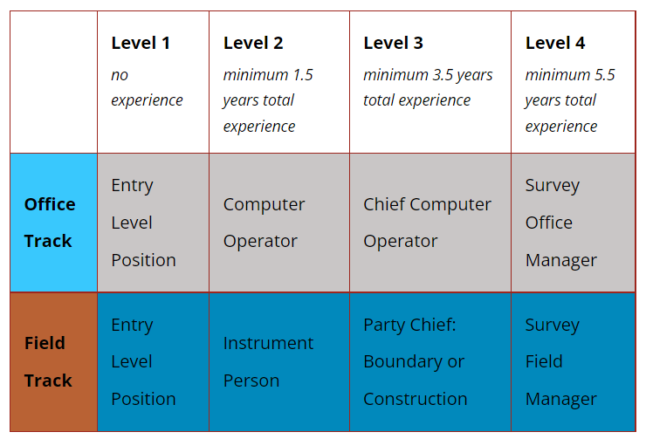
CST TRACK CHART
Survey Technician Certification Program

Slide 10
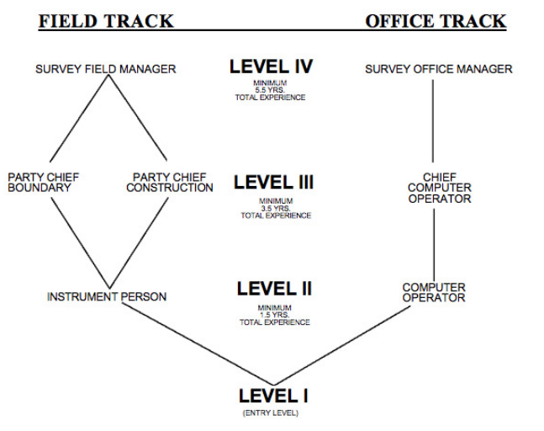
CST TRACK CHART
Survey Technician Certification Program

Slide 11
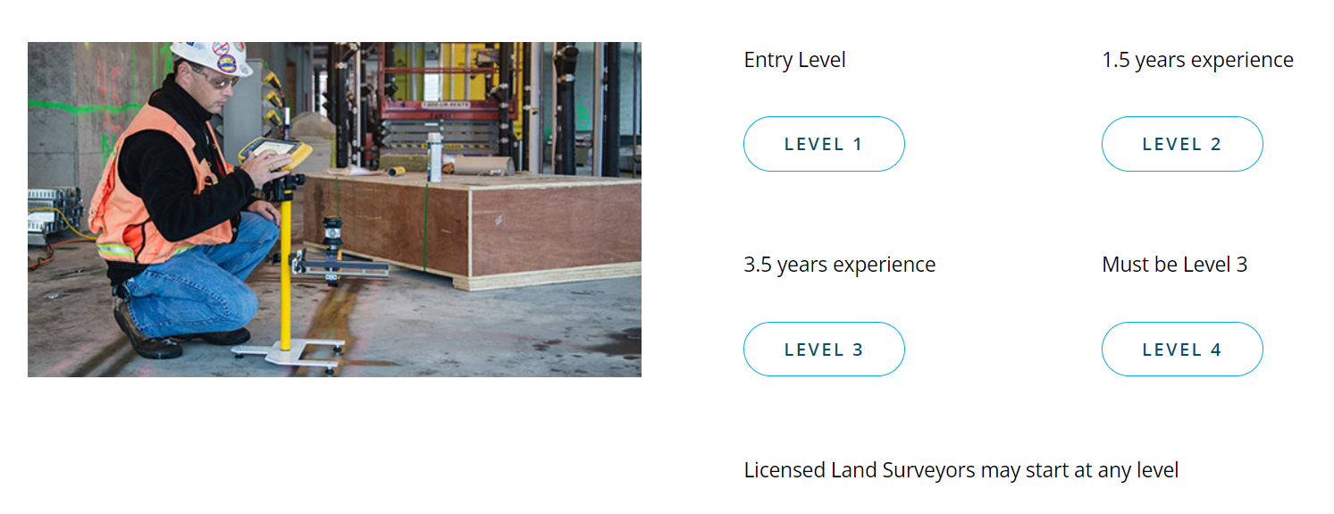
CST STUDY GUIDES
Survey Technician Certification Program

Slide 12
Cst – BY THE NUMBERS
Approximately 950 CST exams are administered yearly
There are over 2400 active CST’s
Survey Technician Certification Program

Slide 13
Cst – CERTIFICATION
Gives important and needed recognition to survey technicians; those who we trust with our license, our reputation and our daily well being and peace of mind.
Survey Technician Certification Program

Slide 14
Cst – Legal Aspects
Certification does not license individuals to practice surveying. Professional surveying licensing is regulated by individual state boards of registration.
This certification program is sponsored by NSPS and should not be confused with any other certification program.
Survey Technician Certification Program

Slide 15
SEALS AND STAMPS
No official seal or stamp for the CST Program
No legal standing
Appropriate recognition:
Signature
CST level
CST certificate number
Ex. Susan S. Smith, CST Computer II (0588-1234)
Any improper use will result in revocation of certification and inability to continue in the CST Program
Survey Technician Certification Program

Slide 16
USES OF THE CST PROGRAM
Registered state apprenticeship program in our area of the profession by private industry or state society.
Validation/Assessment Exam by educational programs.
Working with Military Credentialing Agencies to establish Memoranda of Agreements. Allows members of the military to prepare for civilian certifications prior to leaving the service.
Survey Technician Certification Program

Slide 17
CST PROGRAM USERS - PUBLIC
Virginia State Board of Registration - FS exam
Maryland Society of Surveyors
Washington DC Metropolitan Area Transit Authority
City of Orlando, FL
City of Virginia Beach, VA
Arizona and Minnesota DOTs
Florida Surveying And Mapping Society, Tallahassee, FL
Michigan Society of Professional Surveyors - Survey Technician Council
Texas Society of Professional Surveyors
Department of Public Works, Las Vegas, NV
New Hampshire Land Surveyors Association
District of Columbia Association of Land Surveyors
North Carolina Society of Surveyors
Survey Technician Certification Program

Slide 18
CST PROGRAM USERS - PRIVATE
MSA Consulting - Rancho Mirage, CA
McKim & Creed - Wilmington, NC
Westwood Professional Services - MN
Mid State Technical College - Wisconsin Rapids, WI
E & A Consulting - Omaha, NE
Southeastern Surveying & Mapping - Tallahassee, FL
Jones Carter - Katy, TX
Delta Land Surveying - Lubbock, TX
Vincennes University - Vincennes, IN
FR Aleman - Miami, FL
Control Point Associates - Warren, NJ
C.H. Fenstermaker - Lafayette, LA
Charles P. Johnson & Associates, Inc. - Silver Spring, MD
CEC - Pittsburgh, PA
University of Akron - Akron, OH
Survey Technician Certification Program

Slide 19
Technician benefits:
Recognition by Peers and Employers
Personal Pride - Achieving Certification
Pay – CST’s make about 10% more
Better qualified peers makes your job easier
Career and Employment opportunities improve - “CST Preferred” and “CST Required”
Prepares you for other professional exams
CST Program compliments training
Skills will improve – making advancement possible
Certification improves image of survey technicians within the profession
Survey Technician Certification Program

Slide 20
employer benefits:
Sets a standard for your technical staff
Can be used as a hiring requirement
Can be used as a marketing tool - incorporated in your QA/QC Program
Can be used as a career ladder which creates a promotional tool within your firm or agency
Can be used in conjunction with training
Raises the bar and creates healthy competition
Better qualified staff – more production - more profit – you can pay your staff more – you can attract better staff – your job becomes easier
Better qualified staff – less mistakes – reputation improves – more business
Survey Technician Certification Program

Slide 21
Consumer and public benefits:
Can be used as a contract requirement for Design Build and construction contracts.
Can be used as a pre-qualification requirement in A/E procurement (Brook’s Act).
Can be used as a contract requirement for professional survey services contracts.
Improves confidence in services procured
Survey Technician Certification Program

Slide 22
Exam formats & rules
All exams open book tests.
Bound books. No loose notes.
Level I, II and III are multiple choice exams.
Level IV is take home, open book, essay exam, similar to a college level term paper.
Exam formats: On-line or paper
No personal computers, laptops or keyboard style hand-held computers are allowed at the exams site.
Data collectors are not allowed.
See Calculator policy in Program Book.
Survey Technician Certification Program

Slide 23
Exam notes and recommendations
The exam is a challenging timed test. You must be prepared to move purposefully through four hours of testing.
Study, review, and practice in the Work Element areas is important to prepare you for the questions and to be successful.
These tests require a fair amount of computations.
Study, Study, Study
Research the Work Elements
Practice taking the sample exams and solve as many survey questions as you can
Get into testing shape
See “Setting up a CST Training Program” Power Point for more information
Survey Technician Certification Program

Slide 24
Level I exam
Entry level exam
No minimum experience required
The Level I exam has 200 questions
Four hours allowed for the completion of the exam
Exam budget 1.2 minutes per question or 50 questions per hour
Survey Technician Certification Program

Slide 25
Level I exam
Work Elements Questions
per Examination
1) Survey Types and History 15
2) Field Equipment & Operations 75
3) Survey Control 6
4) Survey Computations 50
5) Office Operations, Plan Reading and Preparation 34
6) First Aid and Safety 20
TOTAL QUESTIONS 200
Survey Technician Certification Program

Slide 26
Level II exam
3000 hours, or 1.5 years of surveying experience required (up to 750 hours can be education = 1 year full-time with a minimum of 12 credit hours per term - 24 credit hours)
130 questions - multiple choice
Four hours allowed for the completion of the exam
Field Track Examination
Office Track Examination
Exam budget 1.85 minutes per question or 32.5 questions per hour
Survey Technician Certification Program

Slide 27
Level II exam
Questions per Examination
Work Elements Field Office
1) Survey Types and History 7 10
2) Field Equipment & Operations 56 25
3) Survey Control 7 7
4) Survey Computation 30 40
5) Office Operations, Plan Reading and Preparation 10 31
6) First Aid and Safety 10 10
7) Principles of the Profession 10 7
Total Questions 130 130
Survey Technician Certification Program

Slide 28
Level III exam
7000 hours, or 3.5 years total of surveying experience required
Field Track: 3000 hours (1.5 years) Level II experience plus 4000 hours (2.0 years) as a party chief required
Office Track: 3000 hours (1.5 years) Level II experience plus 4000 hours (2.0 years) as a chief computer operator required
(Up to 1750 hours can be education = 2.33 years, full-time with a minimum of 12 credit hours per term – 56 credit hours)
The Level III exam has 110 questions
Four hours allowed for the completion of the exam
Exam budget 2.18 minutes per question or 27.5 questions per hour
Survey Technician Certification Program

Slide 29
Level III exam
Questions per Examination Field Field Office
Work Elements Boundary Construction Comp Oper
1) Survey Types and History 5 5 5
2) Field Equipment & Operations 38 49 20
3) Survey Control 5 5 5
4) Survey Computations 16 16 16
Office Operations, Plan Reading 11 11 40 and Preparation
6) First Aid and Safety 8 8 8
7) Boundary Surveys 15 4 4
8) Principles of the Profession 5 5 5
9) Supervisory Skills 7 7 7
TOTAL QUESTIONS 110 110 110
Survey Technician Certification Program

Slide 30
Level IV exam
Must hold a Level III certification to take the Level IV exam
11,000 hours, or 5.5 years total of surveying experience required.
Field Track: 7000 hours (3.5 years) Level II & III experience plus 4000 hours (2.0 years) as a party chief required.
Office Track: 7000 hours (3.5 years) Level II & III experience plus 4000 hours (2.0 years) as a chief computer operator required.
(Up to 2750 hours can be education = 3.66 years, full-time with a minimum of 12 credit hours per term – 88 credit hours)
Survey Technician Certification Program

Slide 31
Level IV exam
One Question
A Formal Technical Report
Two months to complete and return
Typed, complete with research and supporting documentation
Affidavit that the exam was completed by examinee
Survey Technician Certification Program

Slide 32
Testing Locations/Dates
Currently tests are offered via special test sites across the country and online at arranged test sites with approved Proctors.
Tests are given four times a year in quarterly cycles.
It is also possible for college programs and professional organizations to arrange for special testing centers for groups. Special discounts apply to groups of 10 or more.
Visit www.cstnsps.com for current online testing schedule.
Survey Technician Certification Program

Slide 33
Examination and renewal fees
All Test Levels Examination Fee
Student/Military $120.00
Individual $180.00
Annual Certification Renewal Fee - $40.00
Required for advancement in the CST Program
After three years of non-renewal, you MUST re-test to become certified again
Prices subject to change.
Check www.cstnsps.com for updates
Survey Technician Certification Program

Slide 34
Examination results
Graded in Four Cycles
Test Results
Cycle 1 (J F M) end of May
Cycle 2 (A M J) end of August
Cycle 3 (J A S) end of October
Cycle 4 (O N D) end of February
Online results are given immediately at the completion of the exam
Normal passing score 70%
After failure three times, proof of appropriate continuing education required prior to fourth attempt
Or you can step down one level and re-test
Survey Technician Certification Program

Slide 35
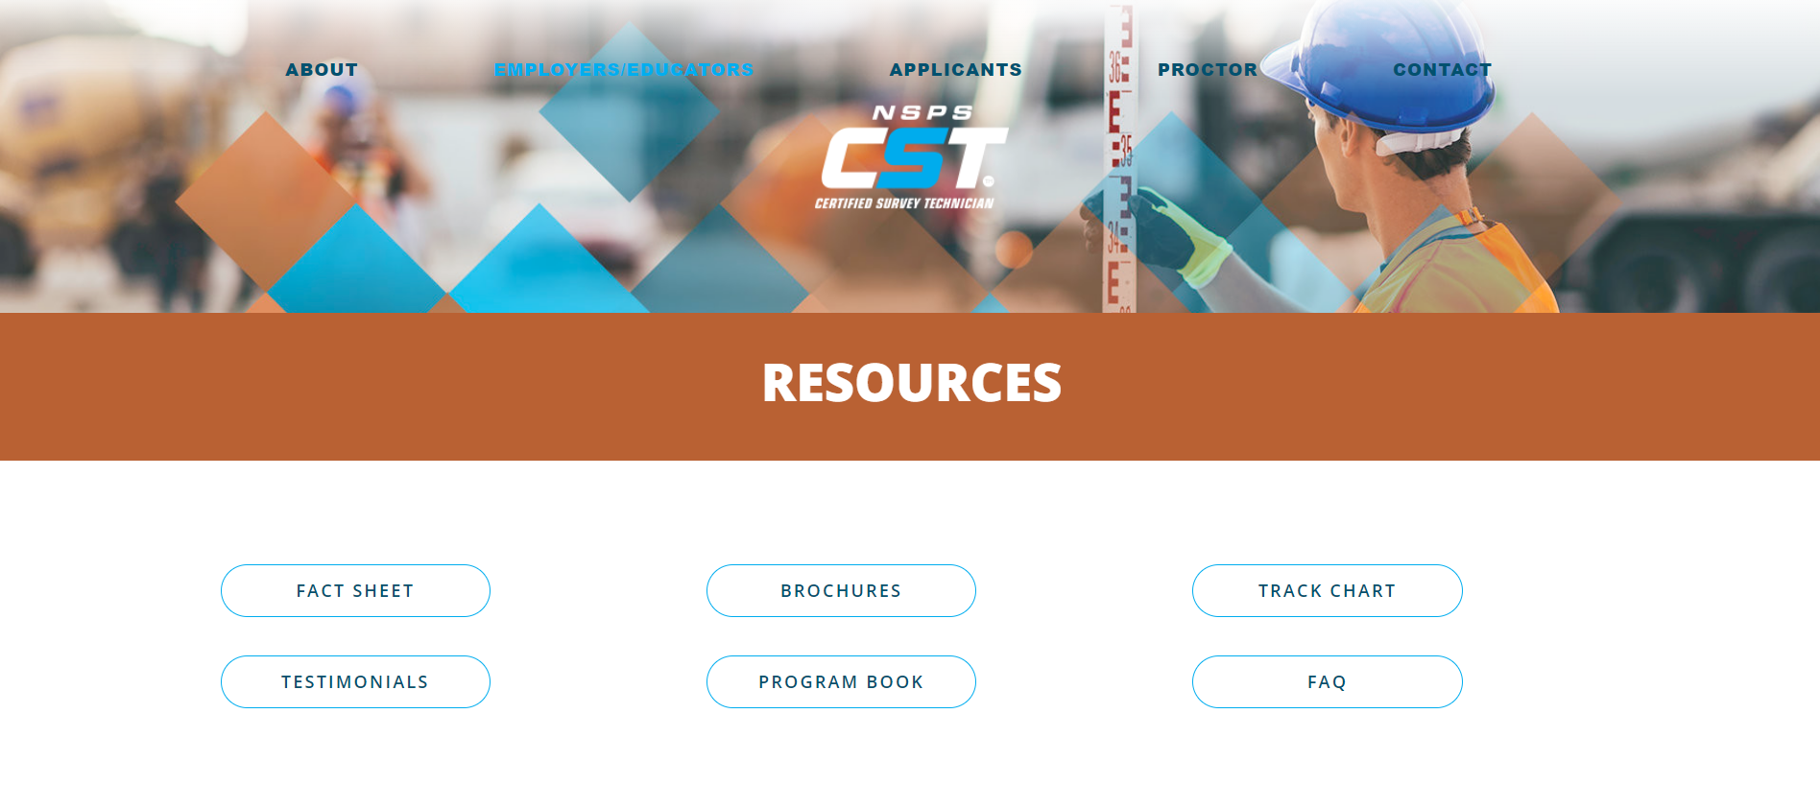
Survey Technician Certification Program

Slide 36
For more information:
21 Byte Court Suite H, Frederick, MD 21702 Phone: 240-439-4615• Fax: 240-439-4952 cstinformation@nsps.us.com
cstnsps.com/contact
Survey Technician Certification Program

